Slide 1

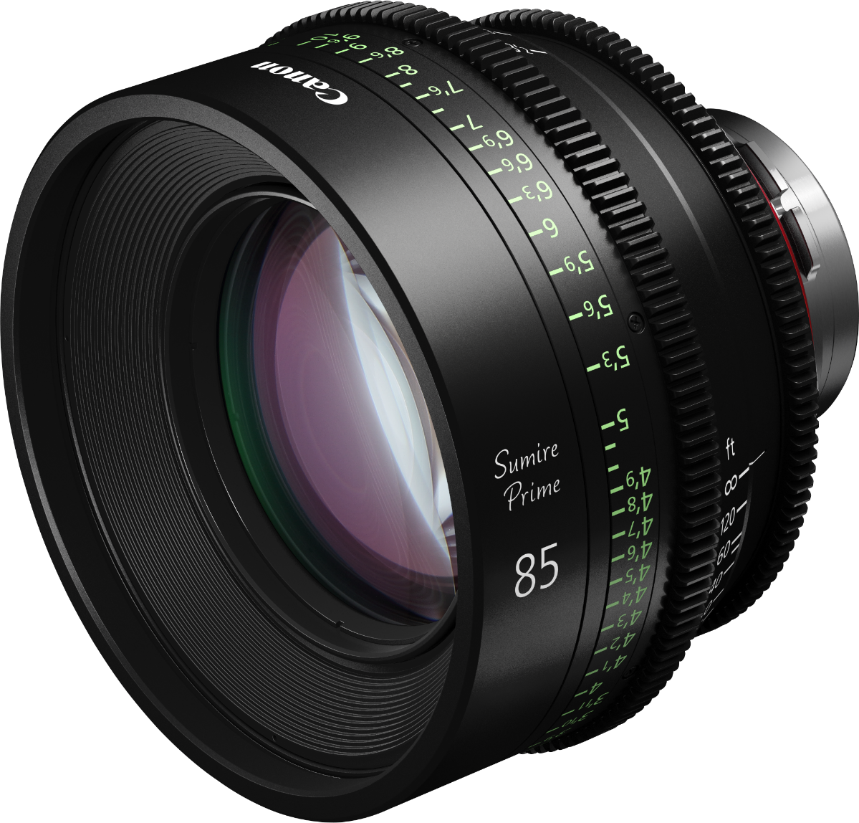
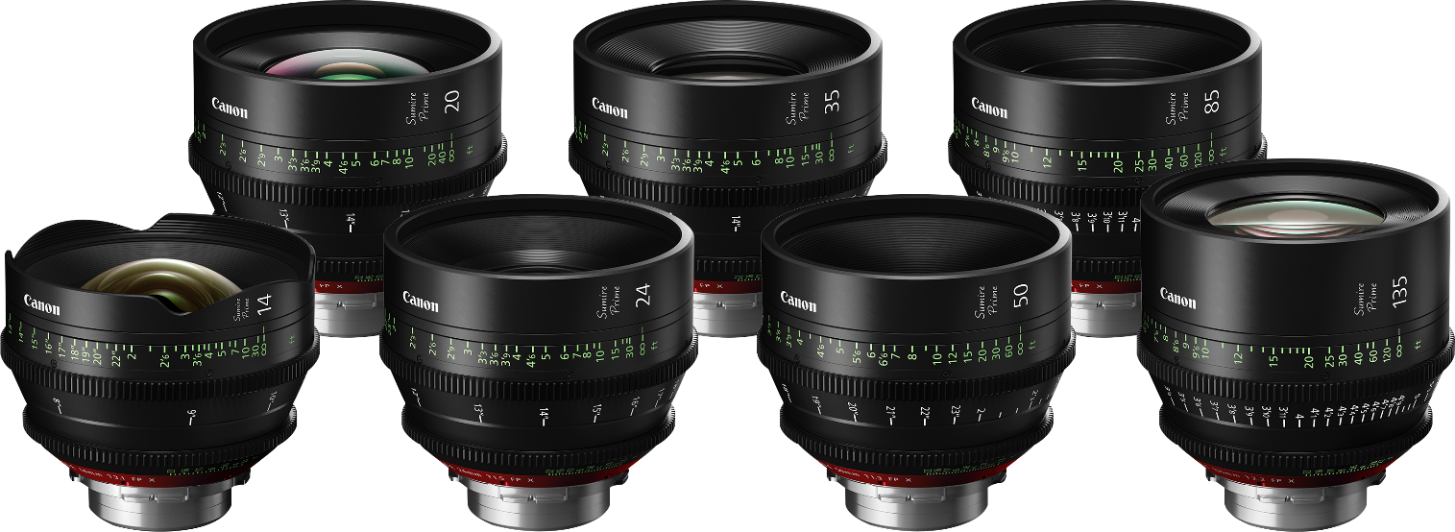



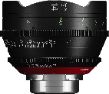
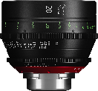
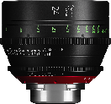
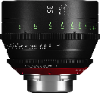
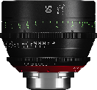
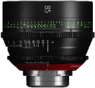
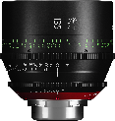
A RANGE OF FULL-FRAME CINEMA PRIME LENSES
WITH A SPECIALLY
DESIGNED ’CINEMATIC LOOK’ AND INTERCHANGEABLE
PL MOUNT.
Designed to offer delicate and subtle rendering of a subject, these seven prime lenses offer fast apertures and precise manual control with a crafted focus bokeh aimed at careful creative expression.
Specially designed ‘cinematic look’
PL mount with Full-Frame coverage
Unified warm colour tone
Fast and bright with beautiful bokeh
Fine focusing with filter and gear consistency
PRODUCT RANGE
CN-E14mm T3.1 FP X
CN-E20mm T1.5 FP X
CN-E24mm T1.5 FP X
CN-E35mm T1.5 FP X
CN-E50mm T1.3 FP X
CN-E85mm T1.3 FP X
CN-E135mm T2.2 FP X

Slide 2
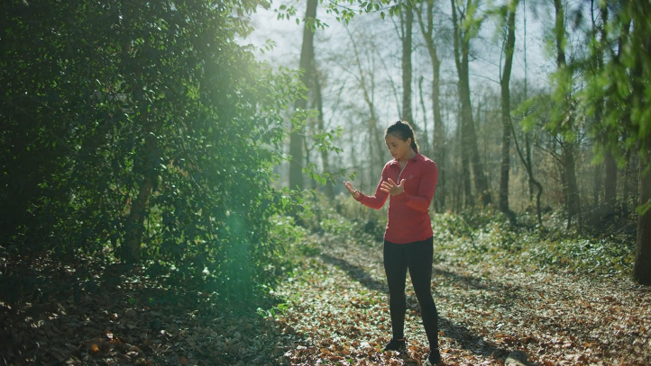

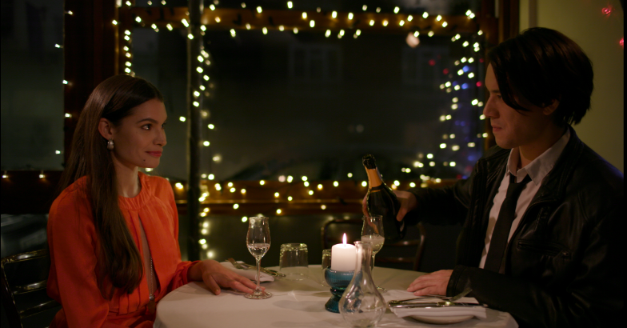
TECHNICAL
SPECIFICATIONS
 | CN-E14mm T3.1 FP X | CN-E20mm T1.5 FP X | CN-E24mm T1.5 FP X | CN-E35mm T1.5 FP X | CN-E50mm T1.3 FP X | CN-E85mm T1.3 FP X | CN-E135mm T2.2 FP X
MOUNT | PL Mount (Interchangeable to EF at authorized service facility)
FOCAL LENGTH | 14 mm | 20 mm | 24 mm | 35 mm | 50 mm | 85 mm | 135 mm
T STOP | T 3.1 | T 1.5 | T 1.5 | T 1.5 | T 1.3 | T 1.3 | T 2.2
NUMBER OF IRIS BLADES | 11 Blades | 11 Blades | 11 Blades | 11 Blades | 11 Blades | 11 Blades | 11 Blades
ANGLE OF VIEW
Aspect ratio 1.5:1 Screen dimensions 36.0×24.0mm | 104.3° × 81.2° | 84.0° × 61.9° | 73.7° × 53.1° | 54.4° × 37.8° | 39.6° × 27.0° | 23.9° × 16.1° | 15.2° × 10.2°
Aspect ratio 1.78:1 Screen dimensions 24.6×13.8mm | 82.6° × 52.5° | 63.2° × 38.1° | 54.3° × 32.1° | 38.7° × 22.3° | 27.6° × 15.7° | 16.5° × 9.3° | 10.4° × 5.9°
MINIMUM OBJECT DISTANCE (from sensor) | 0.20 m／8" | 0.3 m／12” | 0.3 m／12” | 0.3 m／12” | 0.45 m ／18" | 0.95 m／3'2" | 1.0 m ／3'3"
OBJECT DIMENSIONS AT MINIMUM OBJECT DISTANCE
Aspect ratio 1.5:1 Screen dimensions 36.0x24.0mm | 25.2 × 16.8 cm | 33.8 × 22.5 cm | 28.8 × 19.2cm | 20.2 × 13.5 cm | 25.0 × 16.7 cm | 34.4 × 22.9 cm | 21.1 × 14.1 cm
Aspect ratio 1.78:1 Screen dimensions 24.6x13.8mm | 17.2 × 9.7 cm | 23.1 × 13.0 cm | 19.7 × 11.0 cm | 13.8 ×7.7 cm | 17.1 × 9.6 cm | 23.5 × 13.2 cm | 14.4 × 8.1 cm
FRONT DIAMETER | Φ114 mm | Φ114 mm | Φ114 mm | Φ114 mm | Φ114 mm | Φ114 mm | Φ114 mm
APPROX. SIZE (WXHXL) | 118.4 × 118.4 × 86.0 mm | 118.4 × 118.4 × 93.5 mm | 118.4 × 118.4 × 93.5 mm | 118.4 × 118.4 × 93.5 mm | 118.4 × 118.4 × 93.5 mm | 118.4 × 118.4 × 93.5 mm | 118.4 × 118.4 × 107.6 mm
APPROX. MASS | 1.2 kg | 1.2 kg | 1.2 kg | 1.1 kg | 1.1 kg | 1.3 kg | 1.4 kg
PITCH OF FOCUS GEAR
Gear Pitch | 0.8 | 0.8 | 0.8 | 0.8 | 0.8 | 0.8 | 0.8
Focus Dia. | 116.8 mm | 116.8 mm | 116.8 mm | 116.8 mm | 116.8 mm | 116.8 mm | 116.8 mm
Zoom Dia. | - | - | - | - | - | - | -
Iris Dia. | 100.8 mm | 100.8 mm | 100.8 mm | 100.8 mm | 100.8 mm | 100.8 mm | 100.8 mm
Cinematic look
Beautiful bokeh
Reduced focus breathing
Excellent low light performance
Virtually no change in field-of-view when refocussing
Canon Inc.
canon.com
Canon Europe
canon-europe.com
English edition
Canon Europa NV 2019

